Slide 1
Cricket Score Card
C Project

Slide 2
Introduction
The Cricket Score Sheet project is a simple application written in the C programming language.
It employs file management to store data like as runs, wickets, overs, and extras, among other things.
The application may show runs, wickets, batsman and bowler names, overs, extras, bowler economy, batsman strike rate, and so on.
It also shows the game's start and end times.
The source code is comprehensive, devoid of errors, and simple to comprehend.

Slide 3
ABOUT PROJECT | PROJECT DETAILS
Project Name : | Cricket Score Card
Project Platform : | C/C++
Programming Language Used: | C Programming Language
Developer Names: | 1.Soumik Mallick(RA2111003010125) 2.Ishita Banerjee(RA2111003010127) 3.Ritam Biswas(RA2111003010129)
IDE Tool (Recommended): | Visual Studio Code
Project Type: | Basic project with application of Structures,Functions,Arrays,Switch Case,Files
Database: | Stores data in .c file
Upload Date and Time: | July 1, 2022-9:00 am
Refernces: | itsourcecode.com https://www.sourcecodester.com/

Slide 4
Features of Cricket Score Card Project
This project's C source code is incredibly basic, with just seven user supplied functions. They're mentioned here, along with the jobs they're responsible for.
void date() – to store current date or date of game.
void printt() – to print the output in specific format.
void filewrite() – to write in a file on hard drive of computer to store the input data such as runs, wickets, balls, over etc.
void fileread() – to extract or read the data from the file created to store the data.
void fileopen(char) – opens a cricket score sheet project file from the computer.
int limitedinput(int) – to input some limited data.
void newscoresheet() – to create new score sheet in a new file.

Slide 5
When the cricket score sheet project file is run, it performs the following steps:
The project begins by displaying the welcome screen, which fades up to reveal the main menu. There are three choices on the main menu:
1. Create a new score sheet
2. View a previous score sheet
3. Exit
If '1' is entered, the Cricket Score Sheet project prompts for a new score sheet's name. A notice appears on the screen when the file is generated. The user must next fill out the score sheet, which includes the following information:

Slide 6
Inning and date
Name of batsman and run hit by each of them
Name of bowler and run given by each blower
After entering these details, the application prompts the user to press 'e' to amend the information and 'c' to proceed.
When the user selects '2' from the main menu, the application prompts for the file name. The file is shown if it is found. Otherwise, the screen displays an error message.
Exit is the third option on the main menu. The Cricket Score Sheet project is terminated if the number '3' is entered in the main menu.

Slide 7
Cricket Score Card in C
FUNCTIONALITY OF THE CODES WITH SOURCE CODE

Slide 8
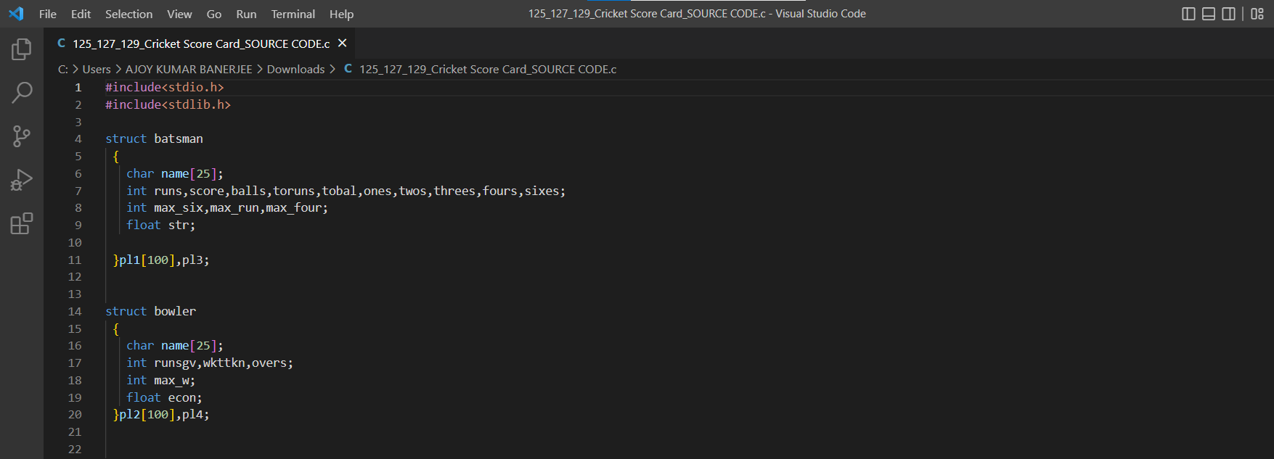
Members of the structures batsman and bowler have been initialized respectively.

Slide 9
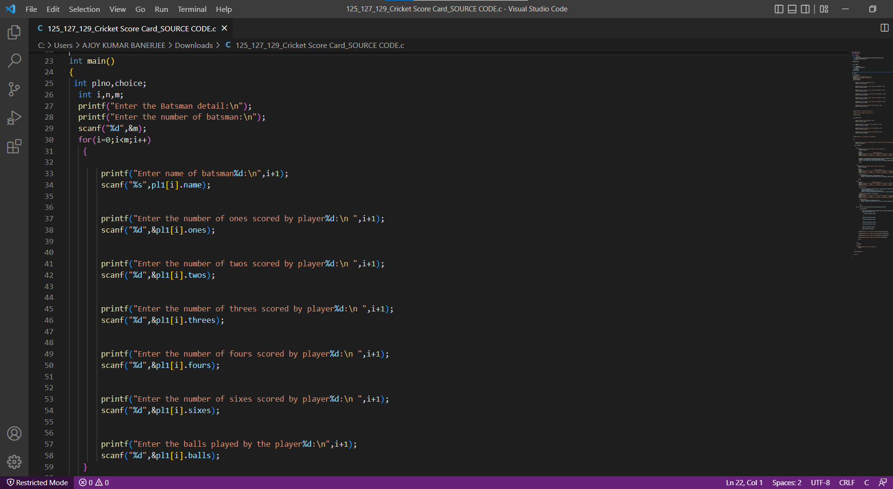
Main() function is declared.
Details of Batsman have been taken as user input referencing the batsman structure.

Slide 10
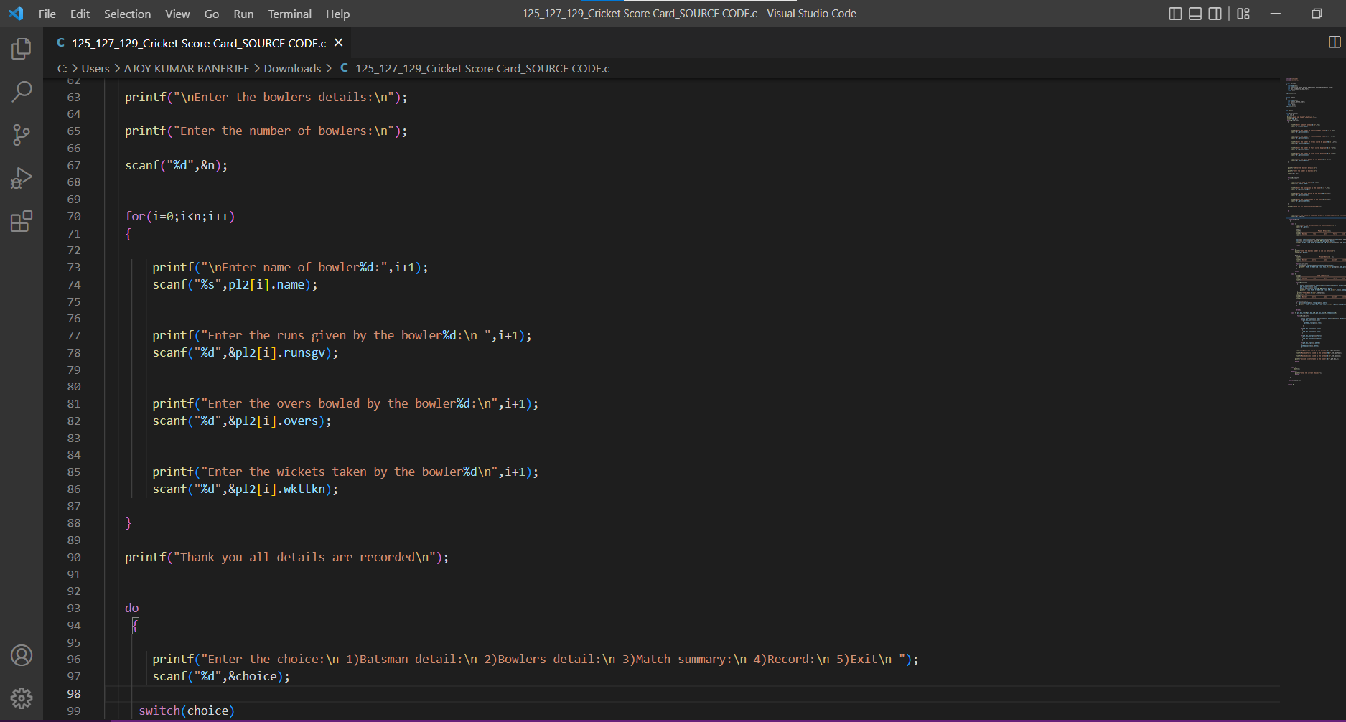
Details of Bowler have been taken as user input referencing the bowler structure.

Slide 11
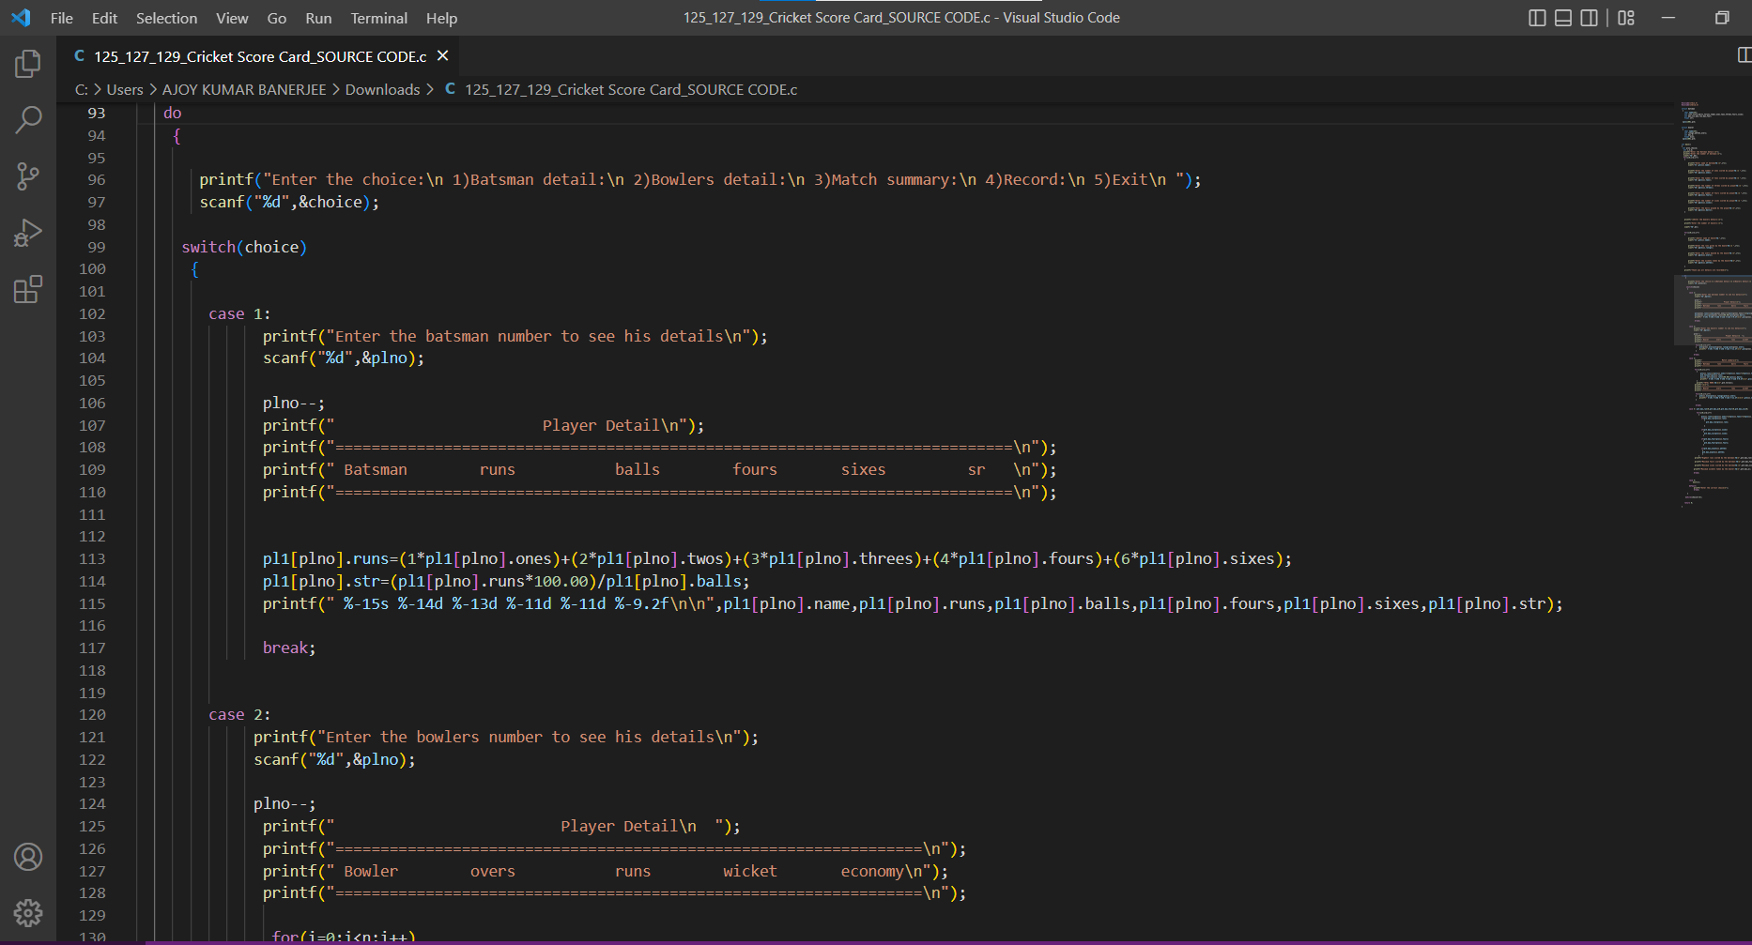
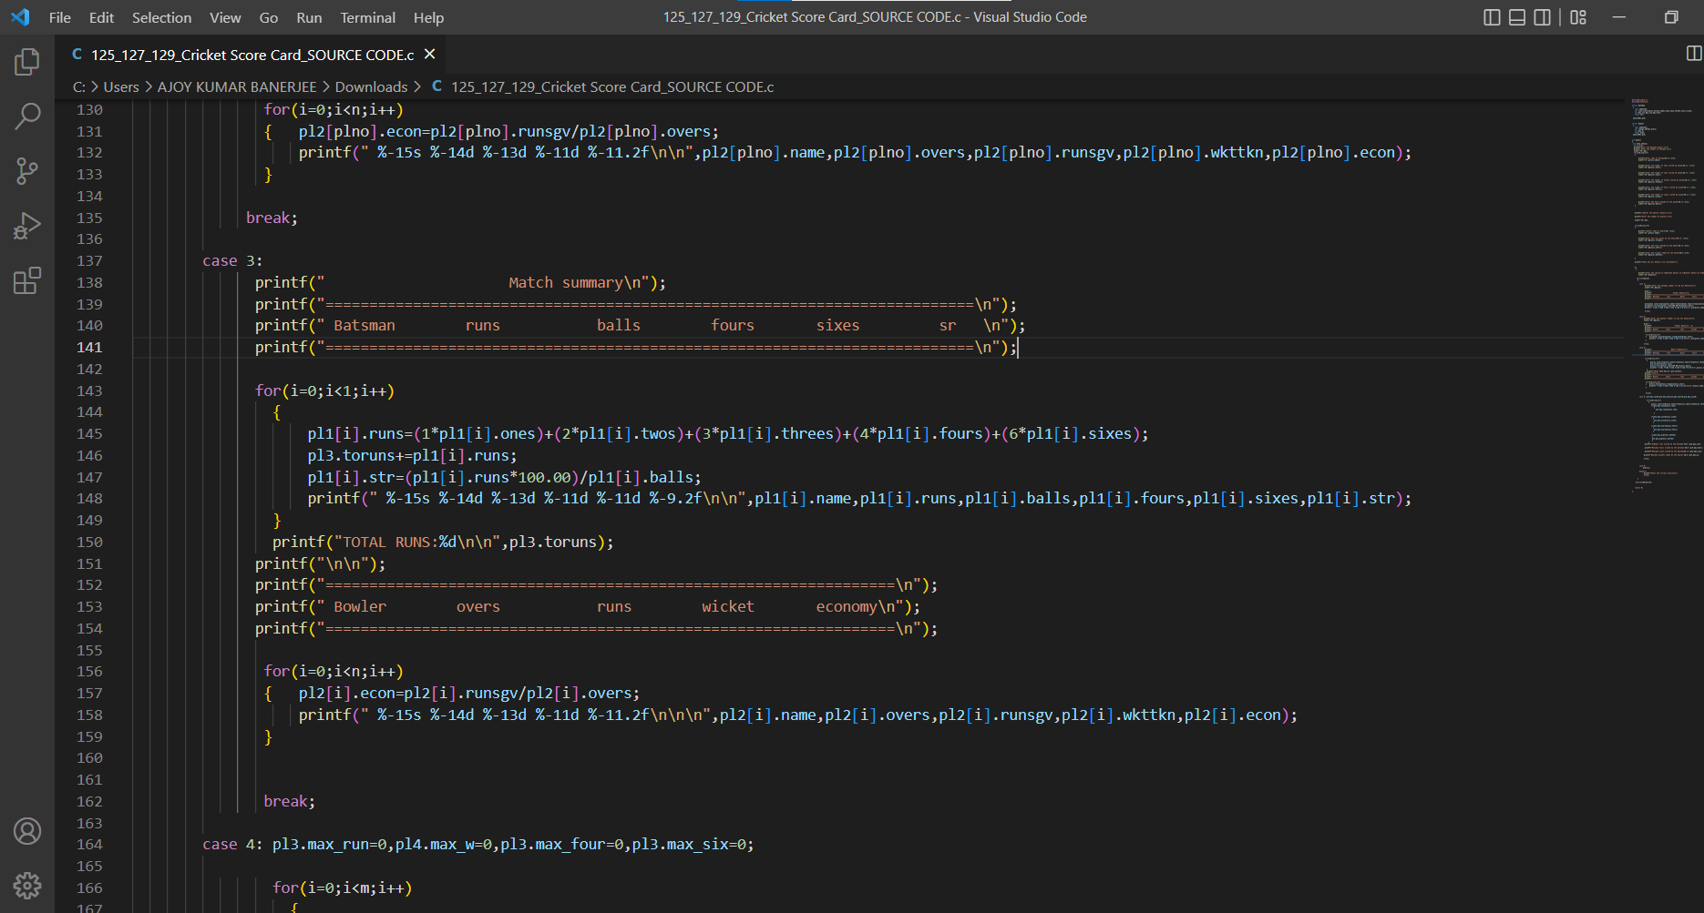
Details of batsman,bowlers and Match Summary are displayed via Switch Case

Slide 12
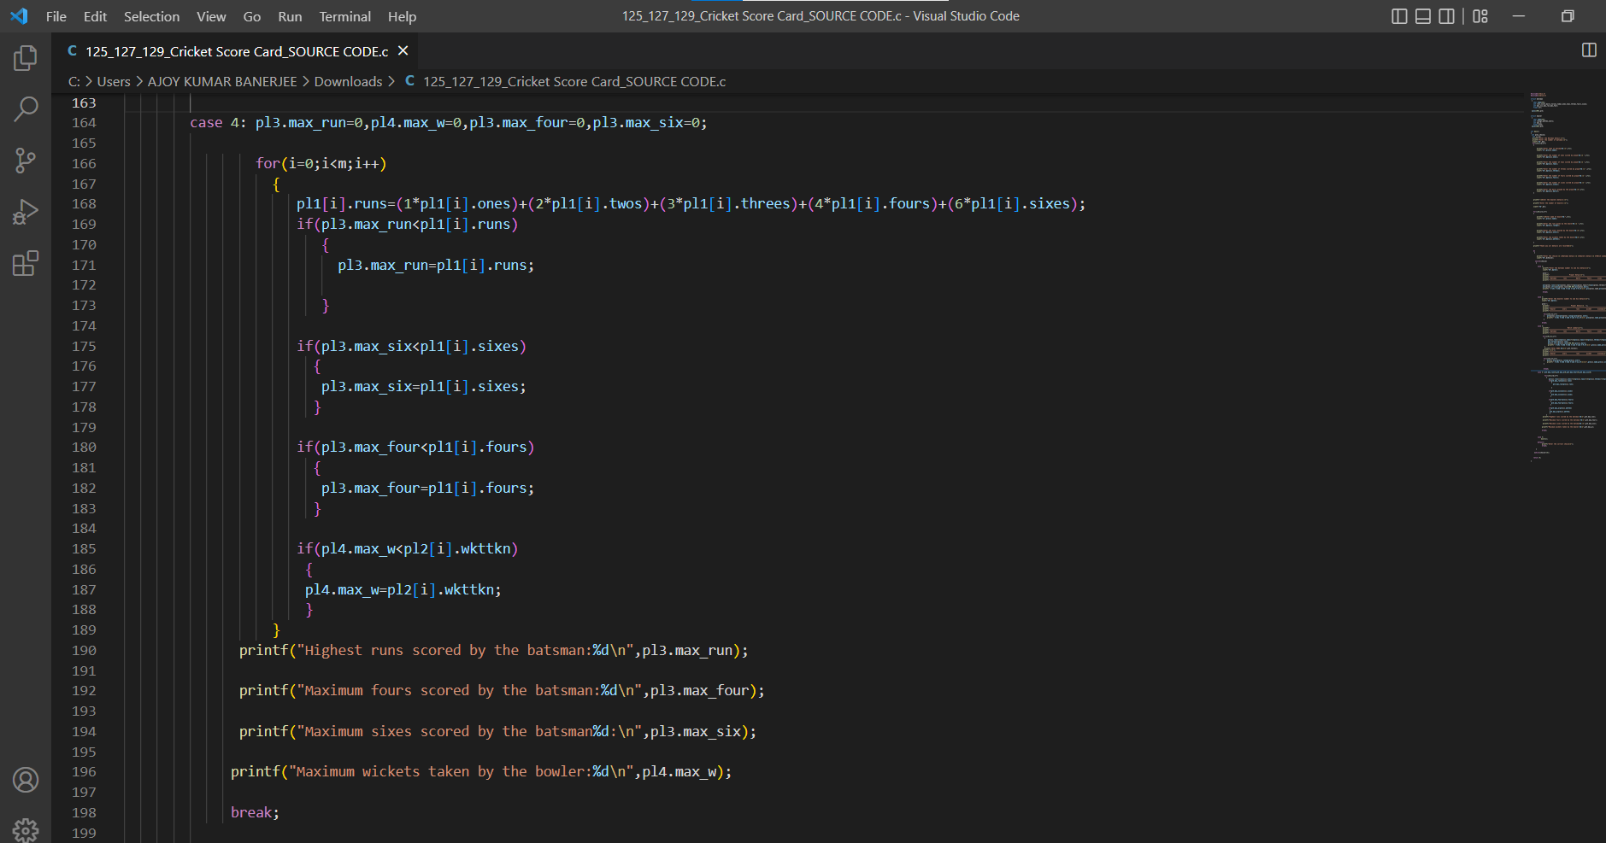
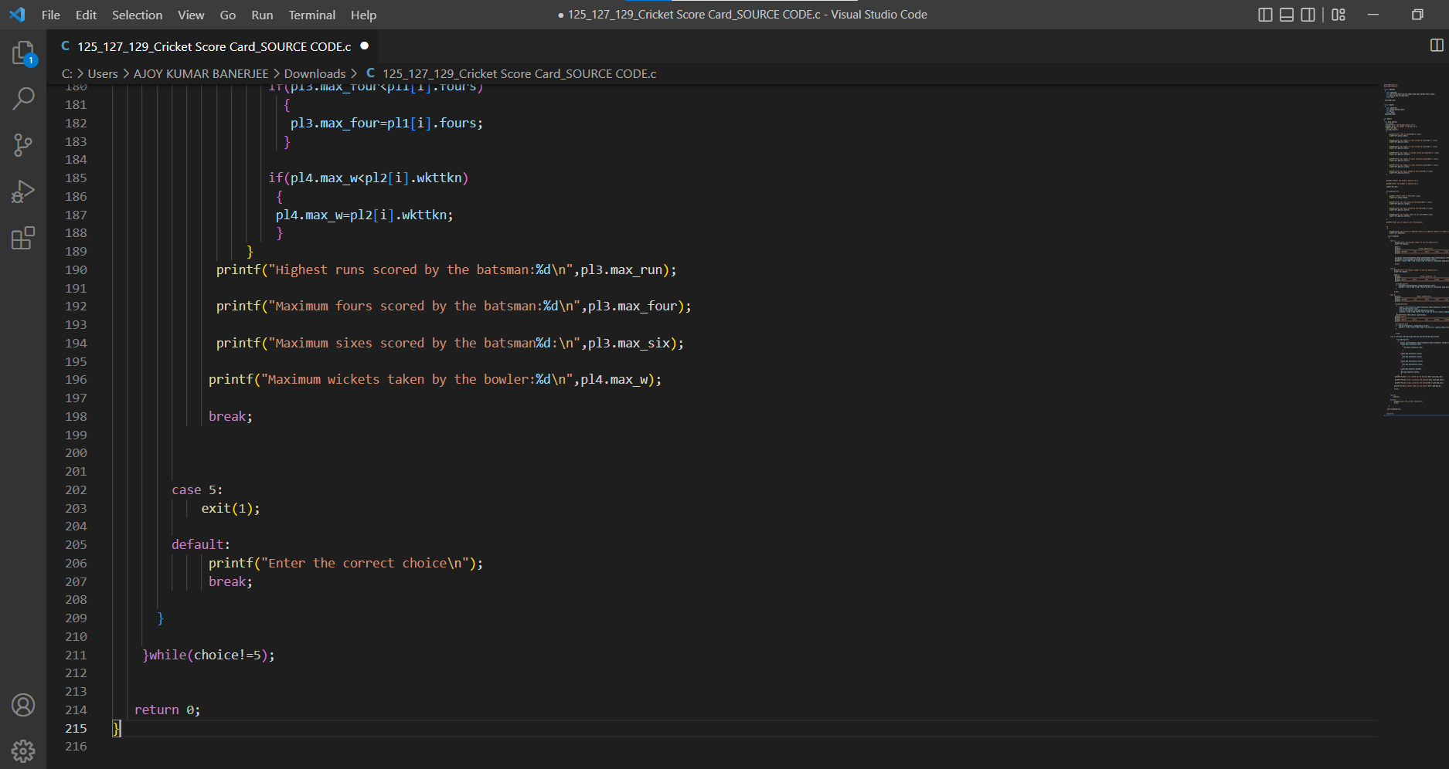
Details of runs scored by batsman and wickets taken by bowler displayed If Case 5 is encountered,the control flow will come out of the do loop.

Slide 13
Team Members
Name | Reg No. | Github Link
Soumik Mallick | RA2111003010125 | https://github.com/Soumik0811
Ishita Banerjee | RA2111003010127 | https://github.com/Ishita-Banerjee09
Ritam Biswas | RA2111003010129 | https://github.com/Ritam-Biswas
Source Code:
Output:

Slide 14
THANK YOU
SECTION: B1
BATCH: 2
Faculty: Dr. Karthikeyan u (102816)
Subject: Programming for problem solving (18css101j)

